Slide 1
Variational pruning of medial axes of planar shapes
Peter Rong, Tao Ju
Washington University in St. Louis
SGP’23, Genoa

Slide 2
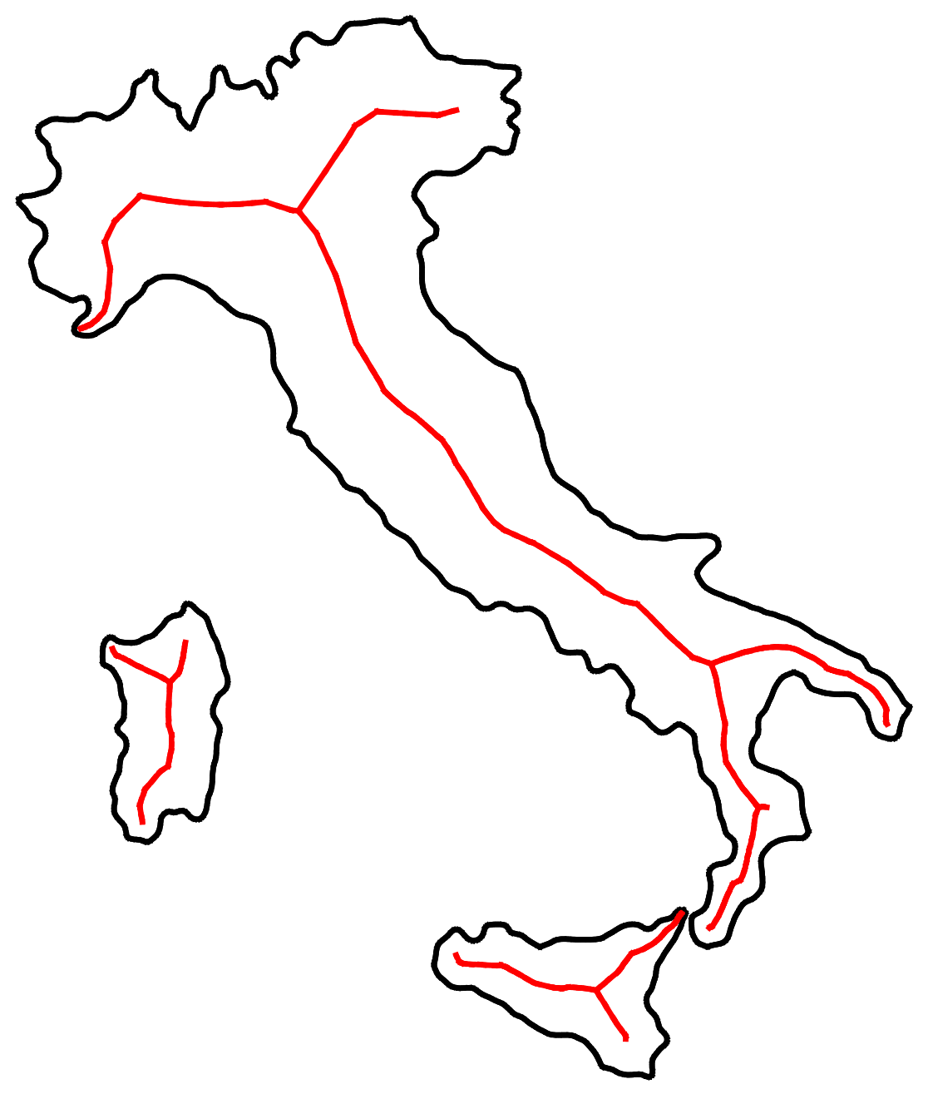
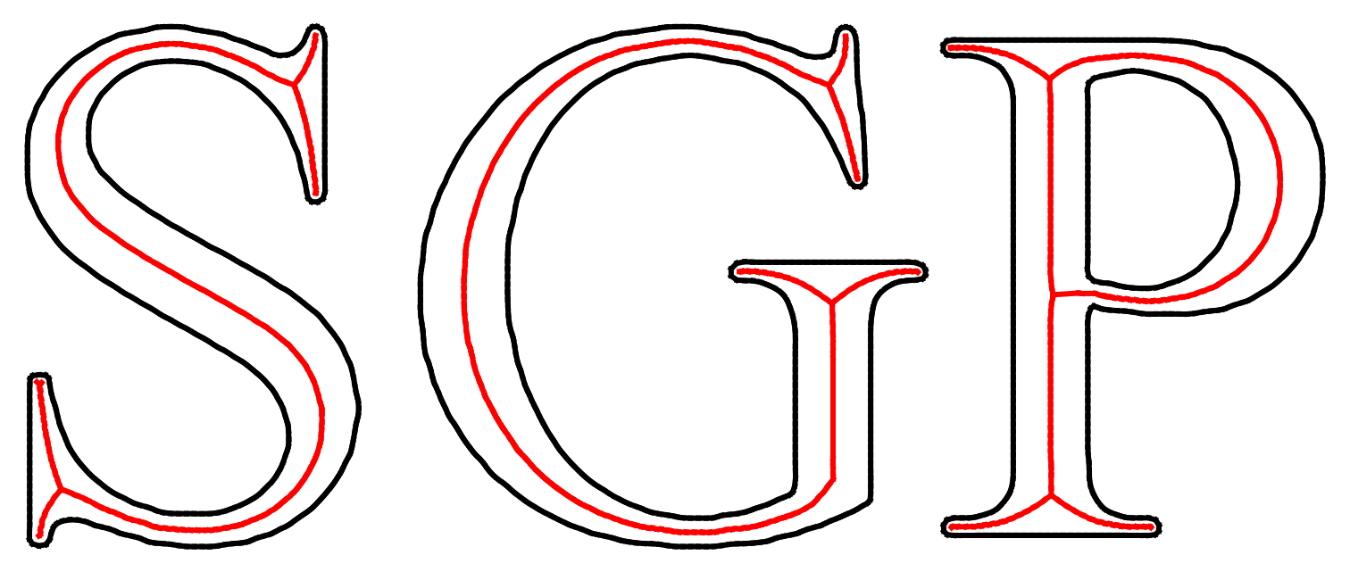
Skeletons of 2D Shapes
Curves centered inside the shape
  Compact representation of connectivity and structure

Slide 3
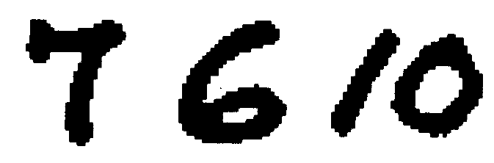
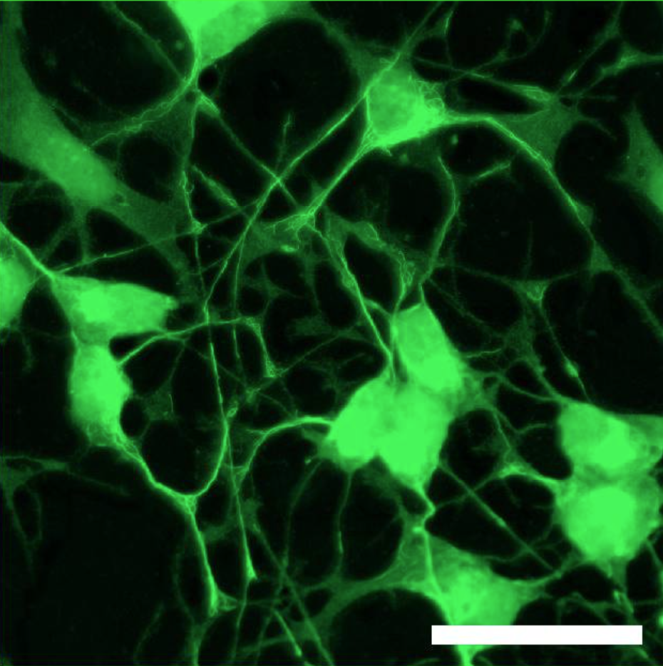
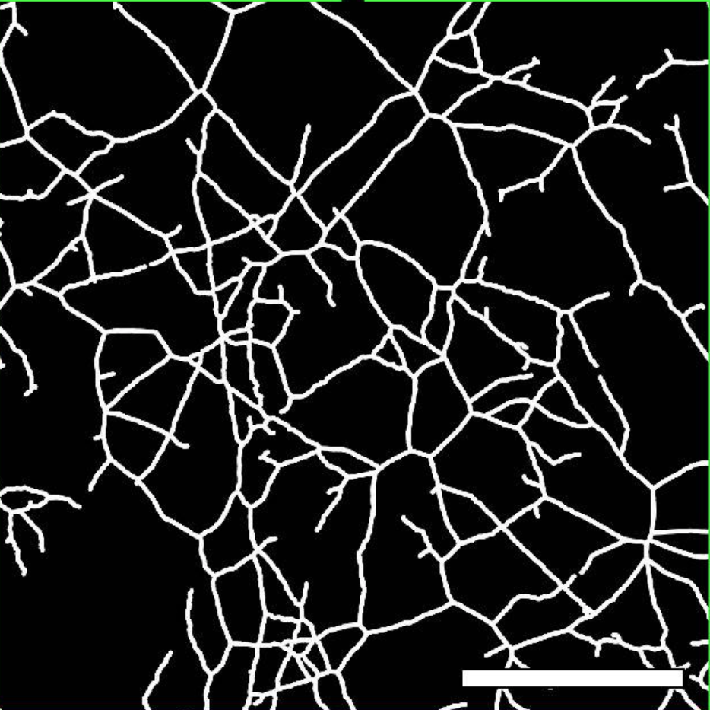
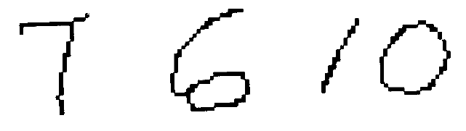
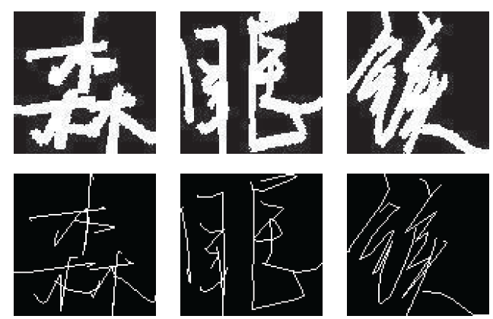
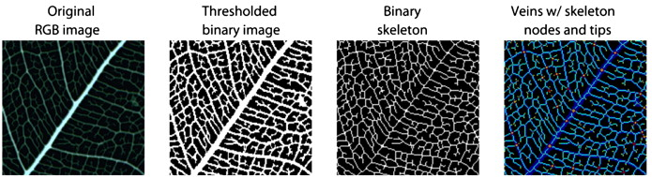
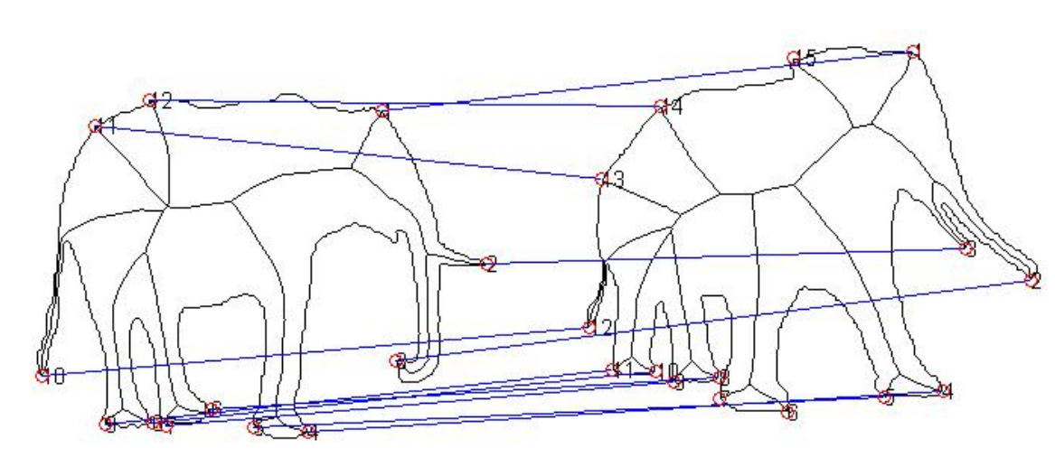
Applications
[Trier 96]
Shape decomposition [Zeng 08]
Neurons [Schikora 21]
[Wang 18]
Leaf veins [Price 11]
Shape matching [Ngo 16]
Character recognition
Biological shape analysis
Notes:
Many apps leverage centeredness: volumetric meshing, roadmap of 3D environments for camera nav, support structures for 3D printing.
The reconstruction property of the medial axis can be used for simplifying 3D shapes by simplifying the medial axis.
As MA captures essential properties of the shape, it serves as an excellent starting point for creating even more compact descriptors, such as curve skeletons, which in turn have many other applications such as shape segmentation, model retrieval, and even animation.
MA has also found applications in other disciplines. For example, it can be used to study the structure of void space in rocks and minerals.
As useful as they are, MA in 3D are difficult to compute.

Slide 4
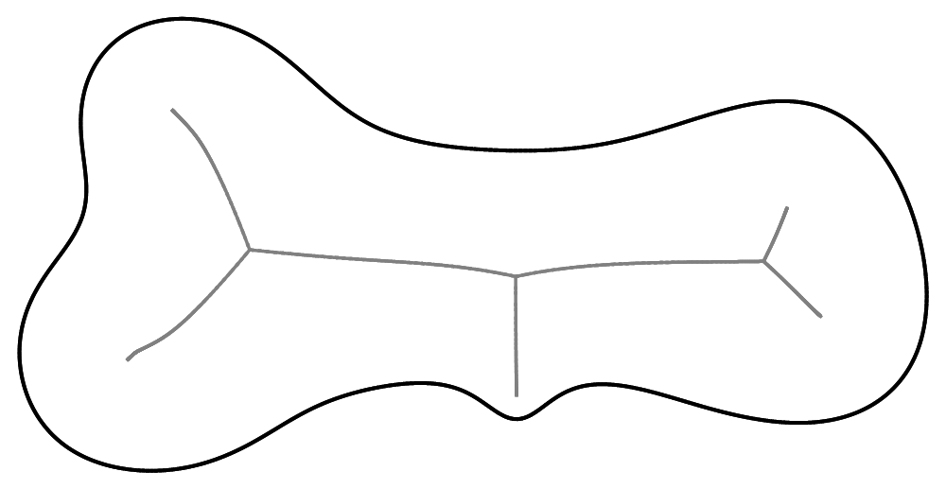
Medial Axis (MA)
Set of interior points with multiple closest boundary points [Blum 1967]
Medial Axis
Boundary
Notes:
In this work, we are interested in the medial axis, which is a concept from computational geometry but has found many applications in graphics, particularly for shape analysis.
Given a shape, the medial axis consists of all points inside the shape that has two or more nearest neighbors on the shape’s boundary. For example, this red point is on the MA because it has two nearest neighbors on the boundary, colored in blue. This green point has three nearest neighbors on the boundary, and it is on the MA too.

Slide 5
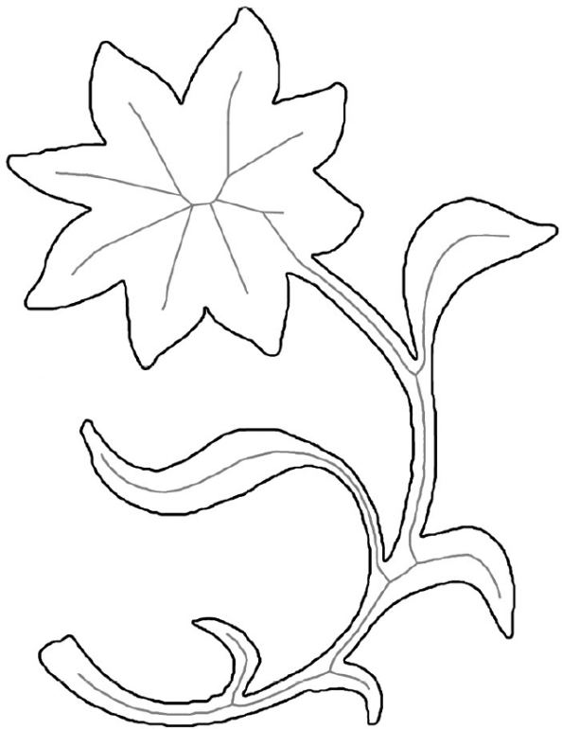
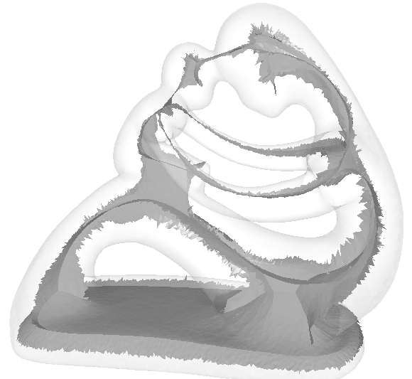

MA Properties
Well-defined in any dimensions
Centered
Thin
  $(N−1)$-D MA for a $N$-D shape
Preserving topology
  Connected components and holes
Capturing structure
  Branching, components, etc.
2D MA
3D MA
Notes:
While the definition is simple, the MA enjoys several properties that make it great for shape description.
By definition, the MA is centered in the shape. In fact, it can be considered as a type of local symmetry axis.
The MA is more compact than the shape in terms of dimensionality. The MA of a 2D shape consists of 1D curves, and the MA of a 3D shape consists of 2D patches.
The MA captures all topological features of the shape, including connected components, topological handles, and voids.
Finally, one can fully recover the shape from its medial axis and the distance from each medial axis point to the shape’s boundary.
In this work, we are interested in the medial axis of 3D shapes, and so I will first highlight a few applications of 3D media axes that leverage these properties.

Slide 6
MA Instability
MA is highly sensitive to boundary noise

Slide 7
MA Instability
MA is highly sensitive to boundary noise
Small bump
Noisy MA branch

Slide 8
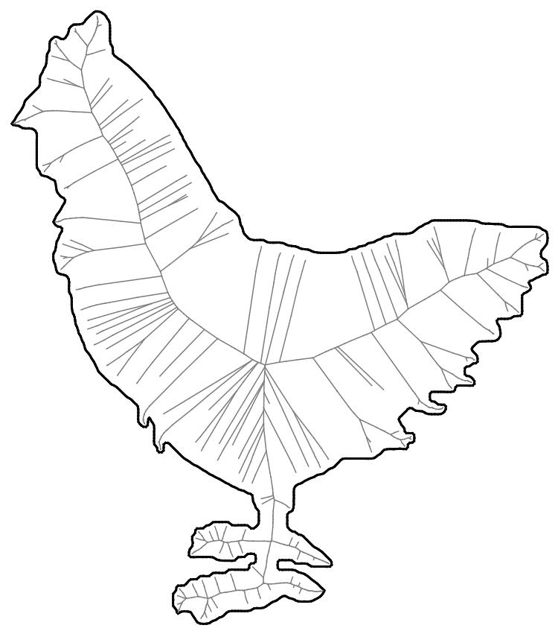
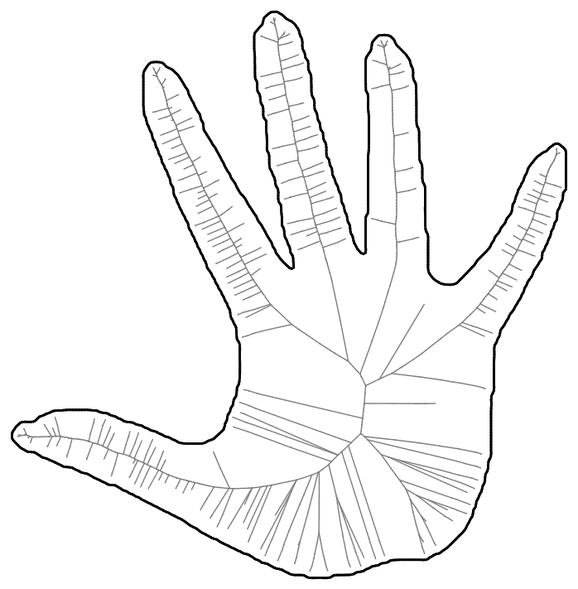
MA Instability
MA is highly sensitive to boundary noise

Slide 9

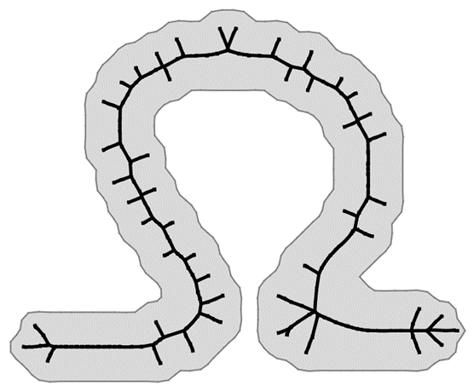
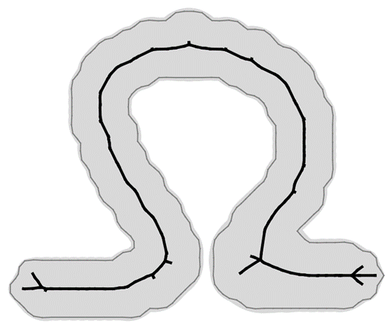
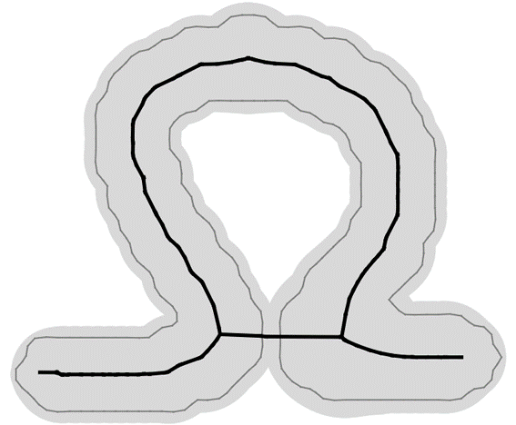
Regularizing MA
Boundary smoothing
  Computing MA after smoothing the shape [Dill 87; Pizer 87; Giesen 09; Miklos 10]
  May lead to change in topology and structure
Scale Axis Transform [Giesen 09]

Slide 10
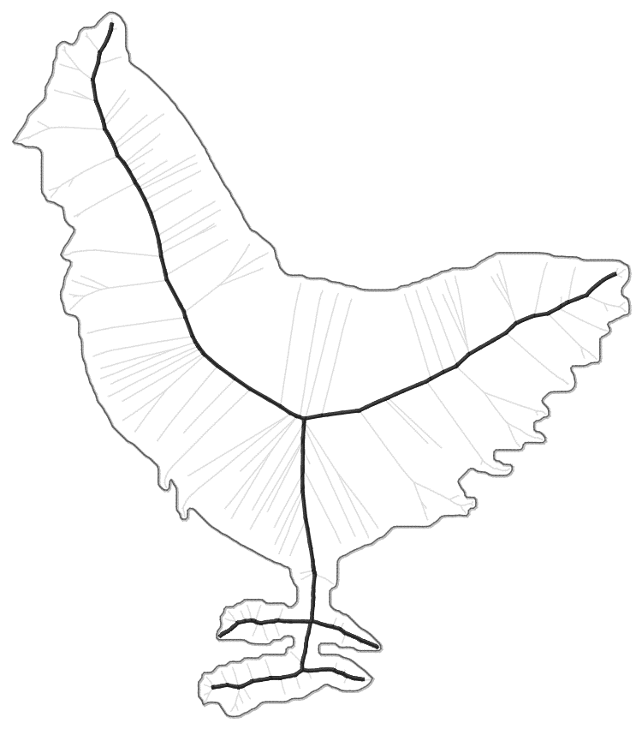
Regularizing MA
MA pruning
  Computing a topology-preserving subset of MA that captures significant shape parts

Slide 11
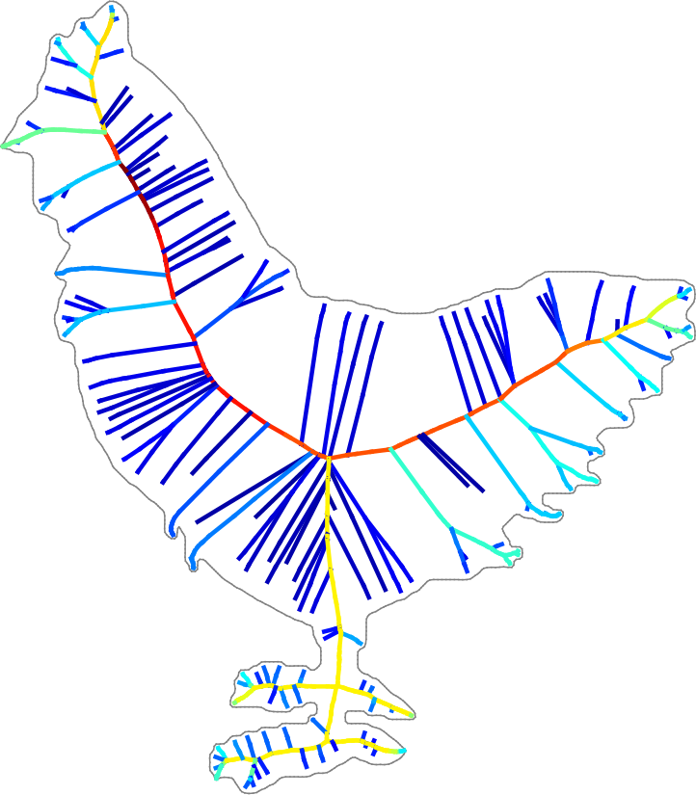
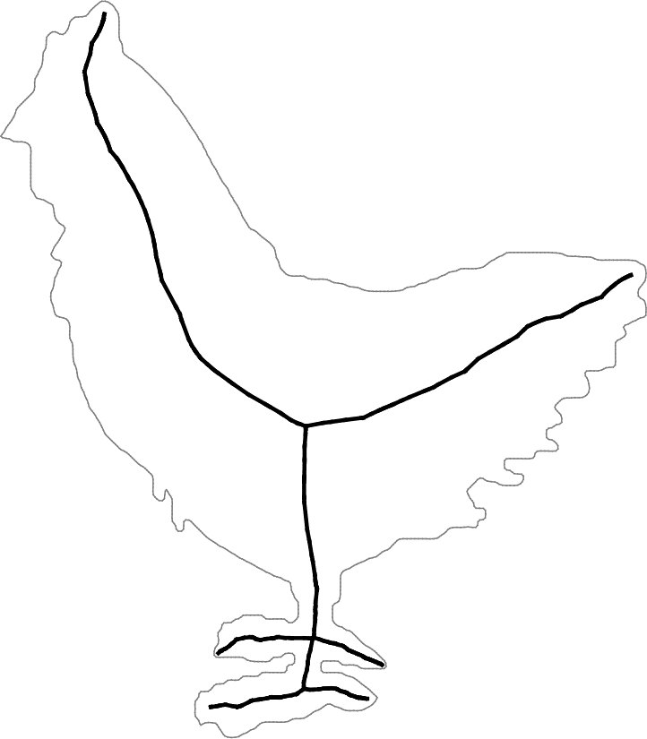
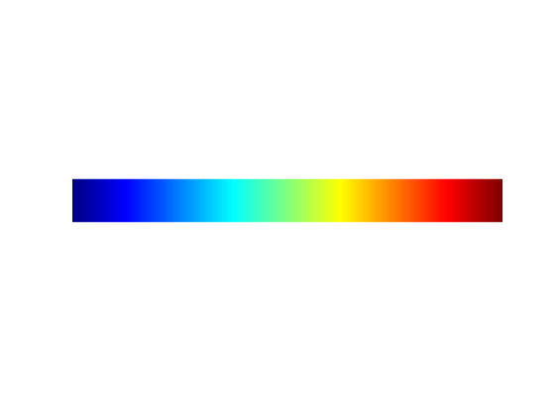
Regularizing MA
MA pruning
  Computing a topology-preserving subset of MA that captures significant shape parts
  Guided by some significance measure
low
high
significance measure

Slide 12
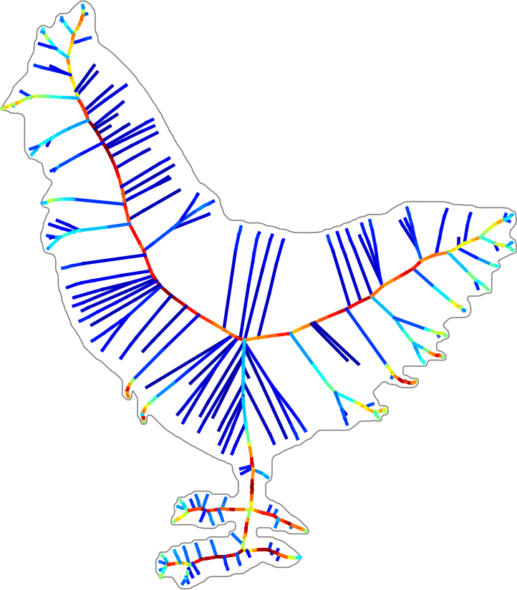
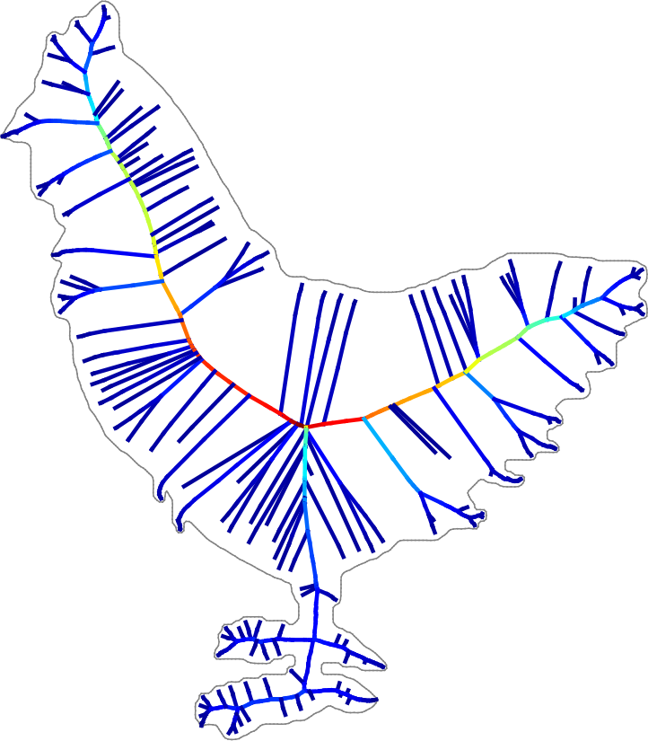
Regularizing MA
Local significance measures
  Object Angle [Attali 96; Amenta 01; Siddiqi 02; Foskey 03; Dey 04]
  Circumradius [Chazal 04; Chaussard 09]
Object Angle
Circumradius

Slide 13
Regularizing MA
Local significance measures
  Often fail to distinguish noise from meaningful MA branches
Object Angle
Circumradius

Slide 14
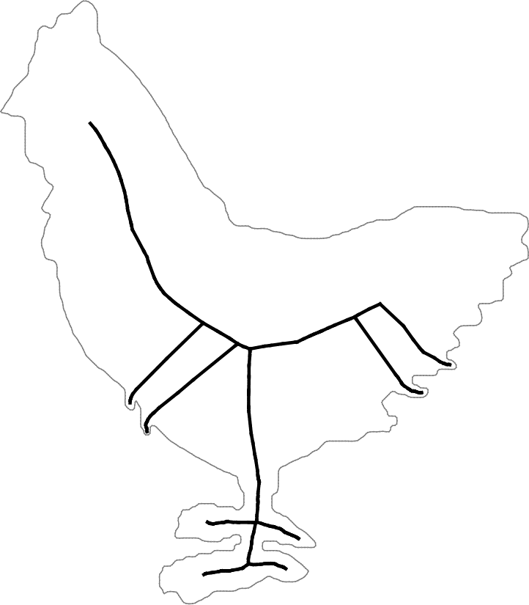
Regularizing MA
Local significance measures
  Often fail to distinguish noise from meaningful MA branches
(pruned MA)
Object Angle
Circumradius

Slide 15
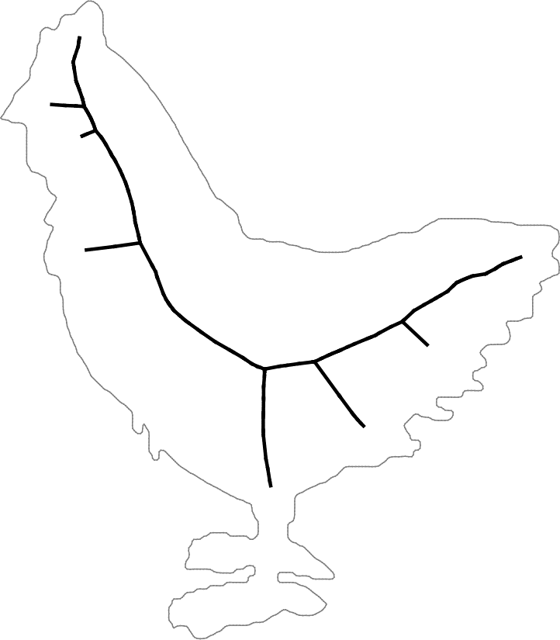
Regularizing MA
Local significance measures
  Often fail to distinguish noise from meaningful MA branches
(pruned MA)
(pruned MA)
Object Angle
Circumradius

Slide 16
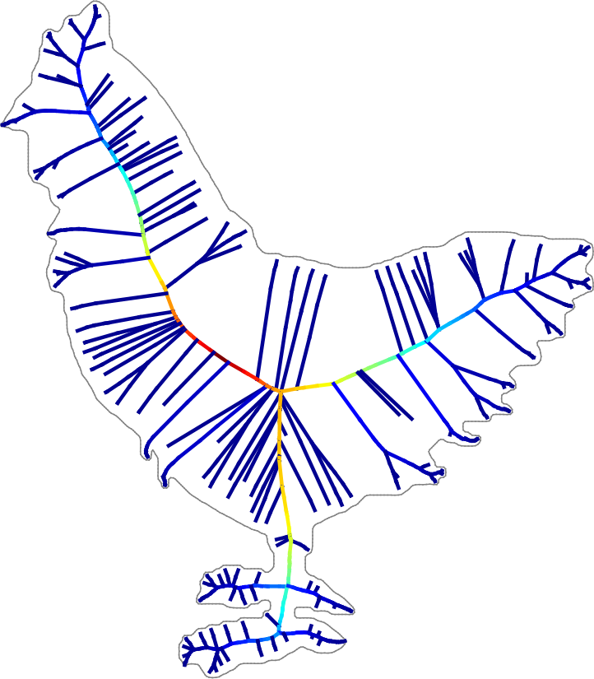
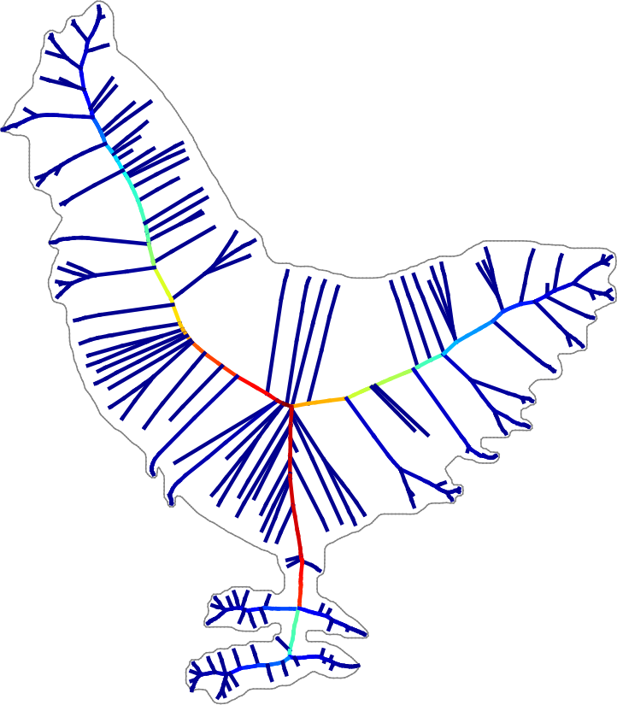
Regularizing MA
Global significance measures
  Erosion Thickness [Ho 86; Brandt 92; Attali 95; Shaked 98; Liu 11]
  Chord Residue [Ogniewicz 92;95]
Erosion Thickness
Chord Residue

Slide 17

Regularizing MA
Global significance measures
  Robustly identify noisy branches
  Low significance near ends of salient MA branches
Erosion Thickness
Chord Residue

Slide 18
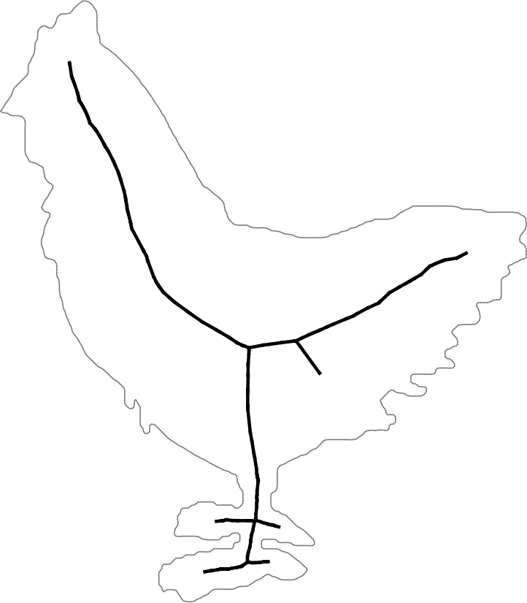
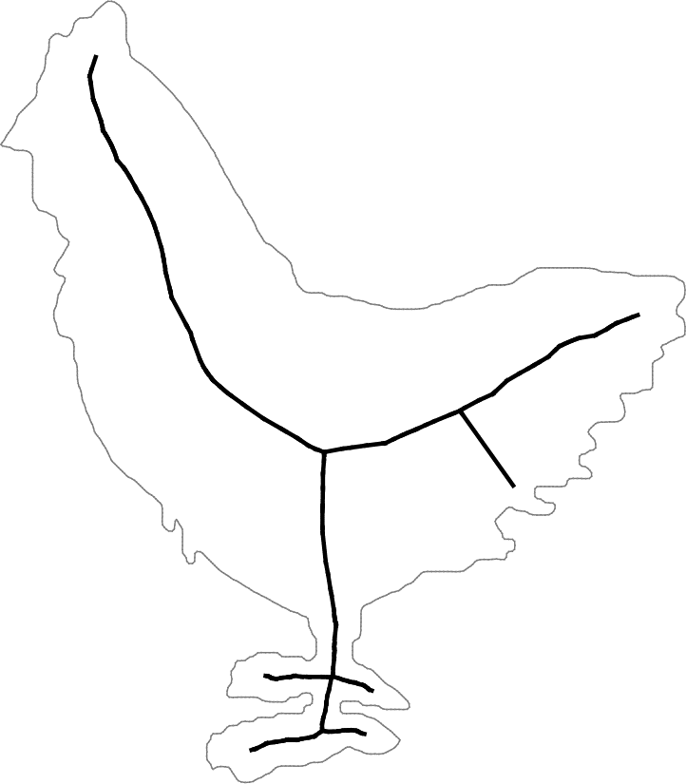
Regularizing MA
Global significance measures
  Robustly identify noisy branches
  Low significance near ends of salient MA branches
  (pruning shrinks MA)
(pruned MA)
(pruned MA)
Erosion Thickness
Chord Residue

Slide 19
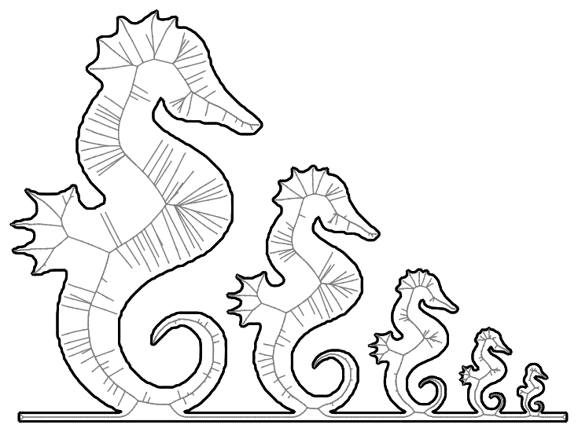
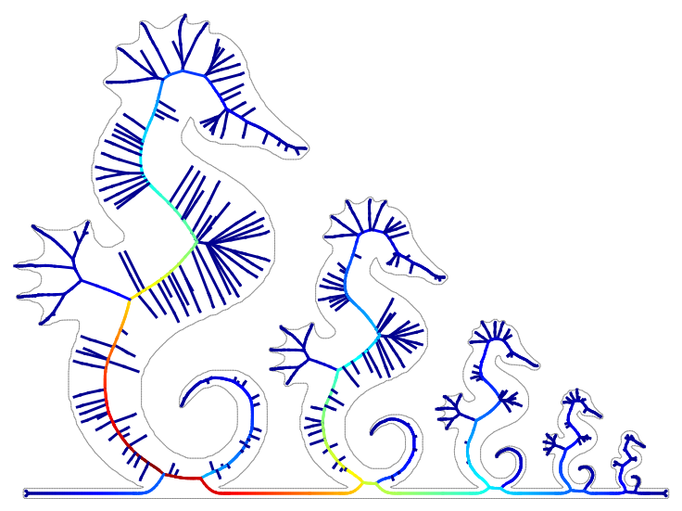
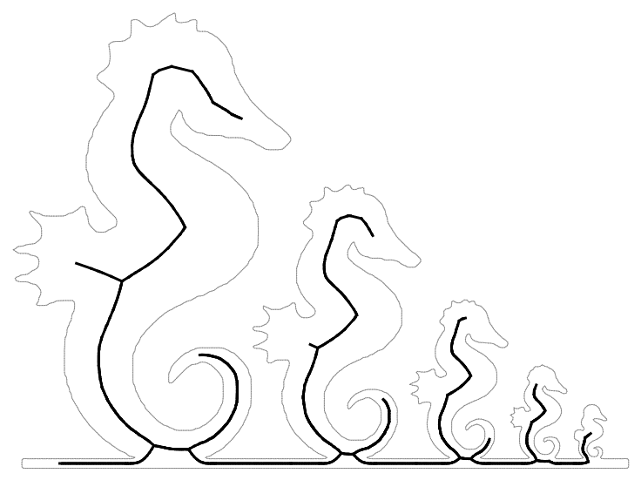
Regularizing MA
Global significance measures
  Robustly identify noisy branches
  Low significance near ends of salient MA branches
    Scale-dependent: more shrinking in smaller shape parts
  (pruning shrinks MA)
Erosion Thickness
Pruned MA

Slide 20
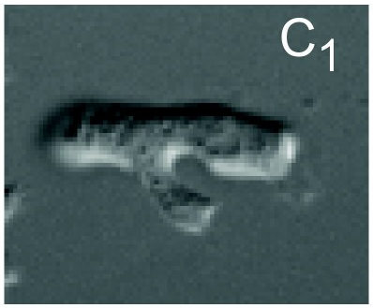
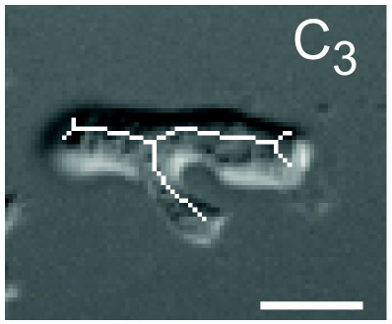
Regularizing MA
A shrunk skeleton is undesirable for:
  Detecting boundary features (e.g., for matching)
  Identifying shape parts
  Skeleton-based analysis (e.g., cell length)
Shape matching [Ngo 16]
Cell shape analysis [Xiong 10]
Shape decomposition [Zeng 08]

Slide 21
Contributions
A new global significance measure for pruning MA of 2D shapes
  Robust against noise (like other global measures)
  Less shrinking on salient branches
Proposed measure
Pruned MA

Slide 22
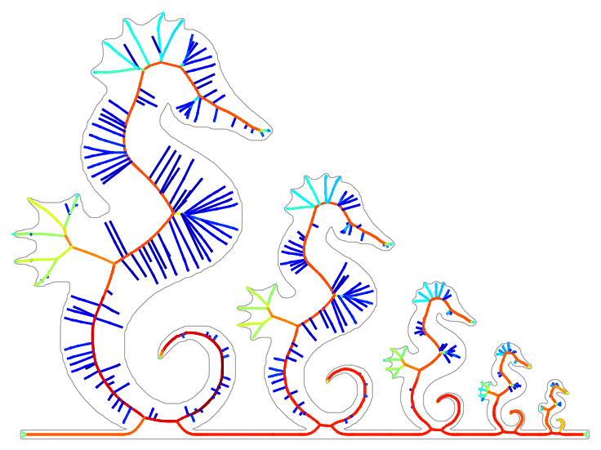
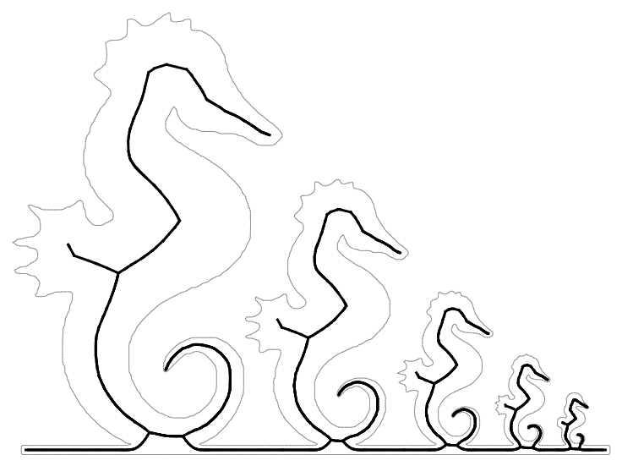
Contributions
A new global significance measure for pruning MA of 2D shapes
  Robust against noise (like other global measures)
  Less shrinking on salient branches
  Scale-invariant
Proposed measure
Pruned MA

Slide 23
Revisiting Object Angle (OA)
OA is high at ends of noisy MA branches
  But also high near ends of salient MA branches
The key observation:
  Most part of a noisy branch has low OA
  But most part of a salient branch has high OA.
Noisy branch
Salient branch

Slide 24
Basic Idea
We prune MA to a subset that:
  Has as many high-OA points as possible, and as few low-OA points as possible
  Preserves MA topology
Noisy branch
Salient branch

Slide 25
Basic Idea
We prune MA to a subset that:
  Has as many high-OA points as possible, and as few low-OA points as possible
  Preserves MA topology
Formulated as a variational problem
  Significance measure derived from the pruned MAs
(few high-OA, many low-OA)
(few low-OA, many high-OA)

Slide 26

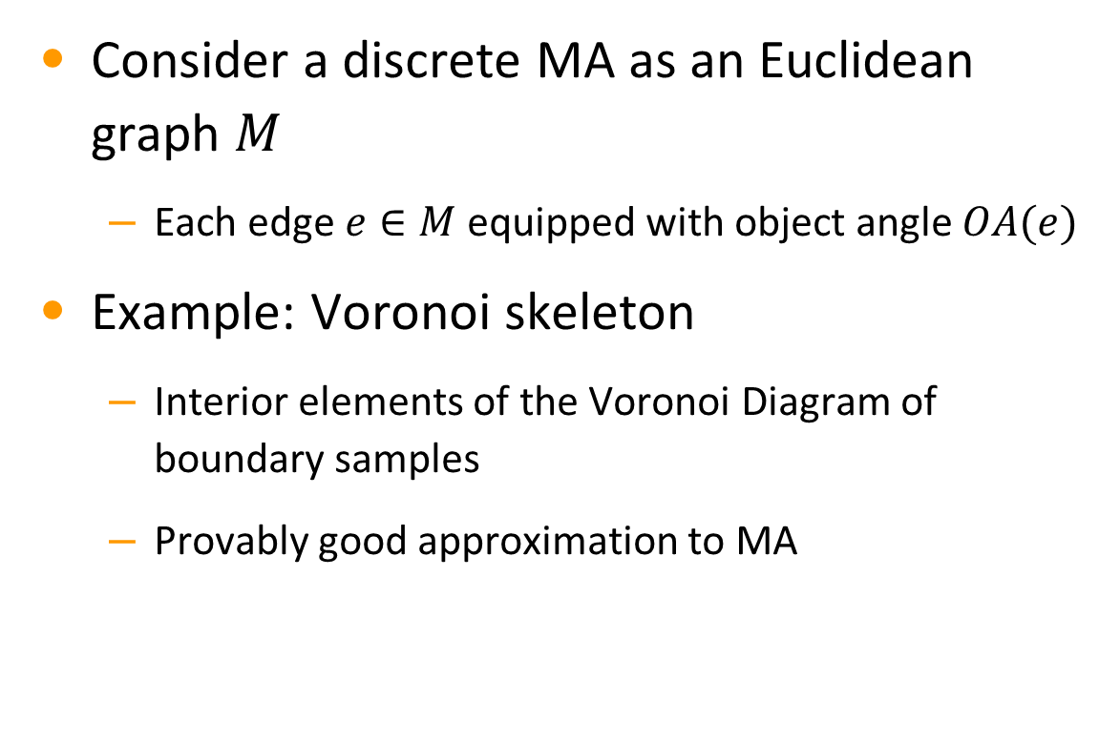
Discrete Formulation
Consider a discrete MA as an Euclidean graph $M$
  Each edge $e∈M$ equipped with object angle $OA(e)$
Example: Voronoi skeleton
  Interior elements of the Voronoi Diagram of boundary samples
  Provably good approximation to MA
Boundary samples
$$M$$

Slide 27
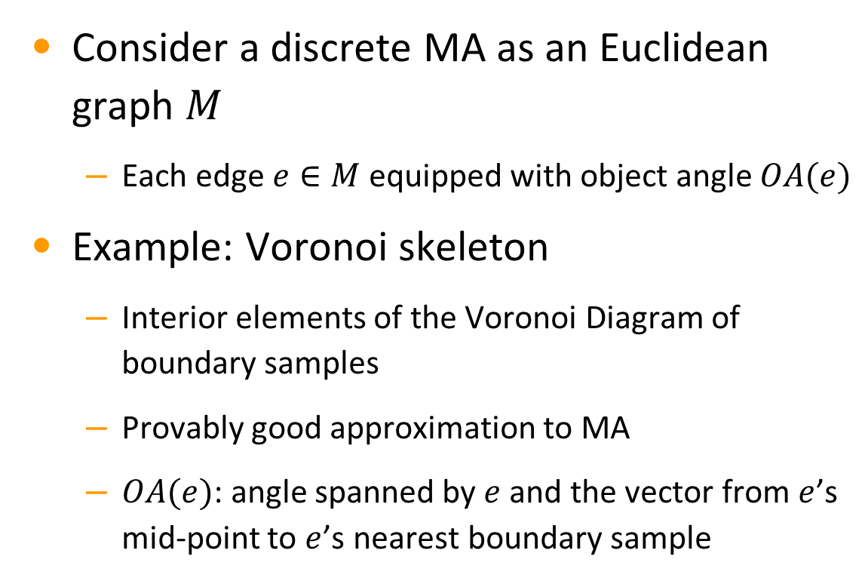


Discrete Formulation
Consider a discrete MA as an Euclidean graph $M$
  Each edge $e∈M$ equipped with object angle $OA(e)$
Example: Voronoi skeleton
  Interior elements of the Voronoi Diagram of boundary samples
  Provably good approximation to MA
  $OA(e)$: angle spanned by $e$ and the vector from $e$’s mid-point to $e$’s nearest boundary sample
Boundary samples
$$OA(e)$$
$$M$$
$$e$$

Slide 28

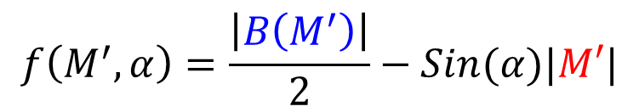

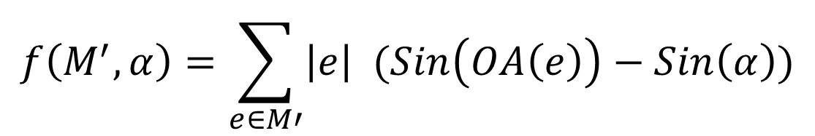

Scoring MA Subsets
Scoring a subgraph $M^{′}⊆M$ for a given OA threshold $α$:
  Higher when $M′$ includes more (fewer) edges with OA greater (smaller) than $α$
  Geometric interpretation (in the continuous setting):
signed
$$f\left(M^{′},α\right)=\sum_{e∈M′}{\left|e\right| (Sin\left(OA\left(e\right)\right)−Sin\left(α\right))}$$
$$B(M^{′})$$
$$f\left(M^{′},α\right)=\frac{\left|B\left(M^{′}\right)\right|}{2}−Sin(α)|M′|$$
$$M′$$

Slide 29

Variational Pruning
Given an OA threshold $α$, we prune $M$ to a subgraph $M_{α}$ such that:
  $M_{α}$ maximizes the score $f(M_{α},α)$
  $M_{α}$ preserves the topology of $M$
  $M_{α}⊆M_{β}$ for any $0≤ β<α$ (i.e., $M_{α}$ contracts as $α$ increases)

Slide 30
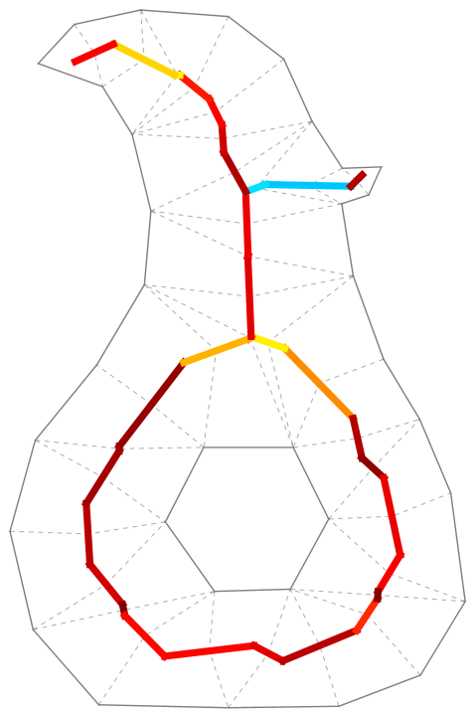
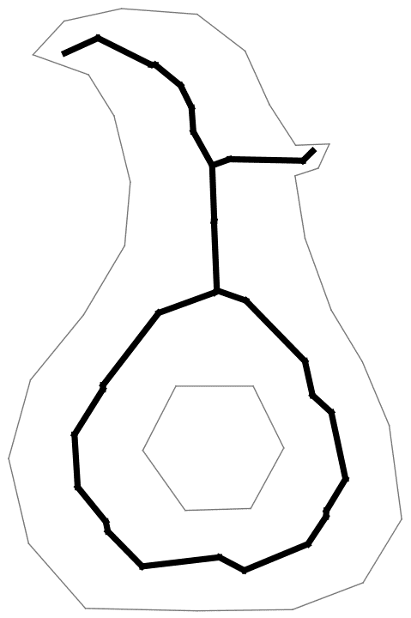
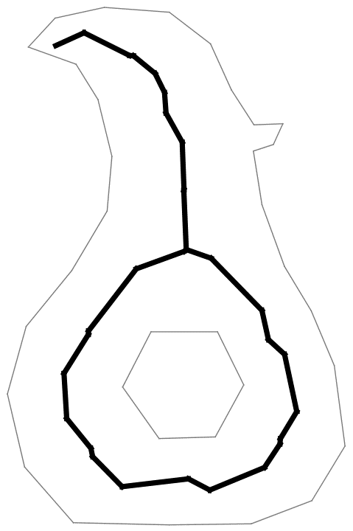
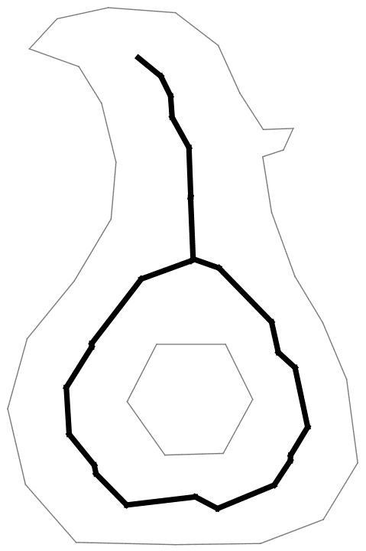
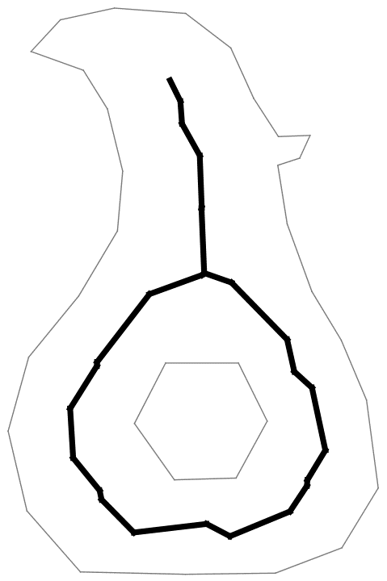
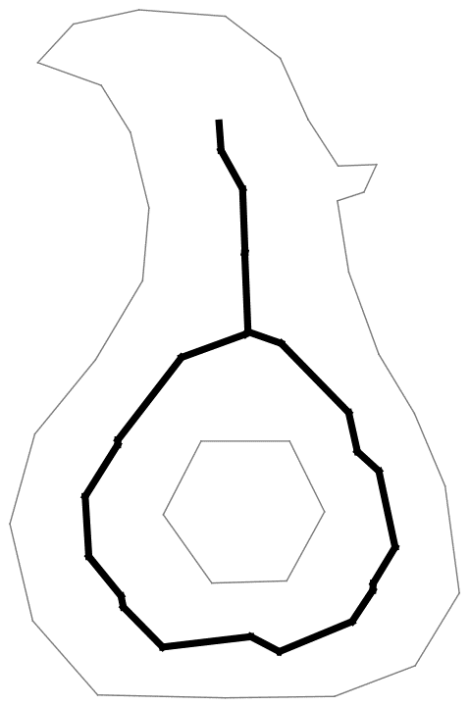
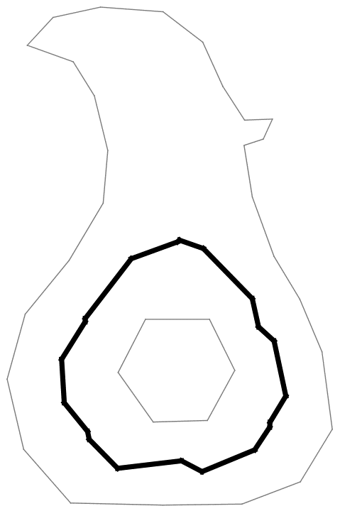







Variational Pruning
Computation: iterative graph contraction
  Starting from $α=0^{∘}$ and $M_{0^{∘}}=M$
  Each iteration seeks the lowest $α$ s.t. some branches of $M_{α}$ have zero total score
  $O\left(n^{2}\right)$ total time for $n$ graph nodes
OA
$$M_{0^{∘}}$$
$$M_{{33}^{∘}}$$
$$M_{{65}^{∘}}$$
$$M_{{76}^{∘}}$$
$$M_{{79}^{∘}}$$
$$M_{{82}^{∘}}$$

Slide 31


Significance Measure
The significance of an edge $e∈M$ is the largest $α$ s.t. $e∈M_{α}$
  Called the Vanishing Angle (VA)
  $M_{α}$ can be obtained by thresholding VA at $α$
    $O(n)$ storage and pruning time
VA
OA
$$M_{0^{∘}}$$
$$M_{{33}^{∘}}$$
$$M_{{65}^{∘}}$$
$$M_{{76}^{∘}}$$
$$M_{{79}^{∘}}$$
$$M_{{82}^{∘}}$$

Slide 32



Results
Robustness against noise
Medial Axes

Slide 33



Results
Robustness against noise
Vanishing Angle

Slide 34




Results
Robustness against noise
Pruned MA ($M_{{50}^{∘}}$)

Slide 35

Results
Comparing with other global measures
Erosion Thickness
Chord Residue
Vanishing Angle

Slide 36


Results
Comparing with other global measures
Erosion Thickness
Chord Residue
Vanishing Angle
(pruned MA)
(pruned MA)
(pruned MA, $M_{{50}^{∘}}$)

Slide 37

Results
Comparing with other global measures
Medial Axis

Slide 38



Results
Comparing with other global measures
Erosion Thickness
Chord Residue
Vanishing Angle

Slide 39



Results
Comparing with other global measures
Erosion Thickness
Chord Residue
Vanishing Angle
(pruned MA)
(pruned MA)
(pruned MA, $M_{{50}^{∘}}$)

Slide 40






Limitations
Designed for tubular shapes
  Non-tubular parts can get pruned quickly
Maxima may not be the shape center
  Located in a strongly tubular part
Vanishing Angle
Pruned at ${45}^{∘}$
Pruned at ${50}^{∘}$

Slide 41

Future Work
Extension to 3D
  Directly applicable to a curve skeleton (equipped with OA)
  What about a 3D MA (a 2D non-manifold)?
Curve skeleton
Medial Axis

Slide 42


Questions?
Code and data

